Slide 1
OpenACC
Tutorial

Slide 2
What is OpenACC
Open Accelerators
Through various compiler directives to write GPU code
Lower the technical barriers to GPU programming

Slide 3
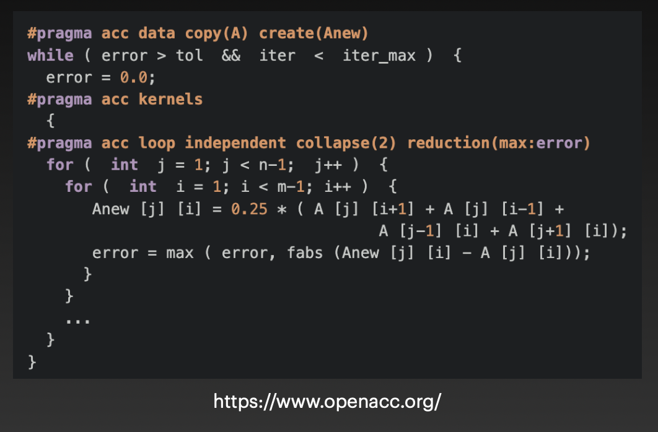
What is OpenACC

Slide 4
CUDA
CudaMalloc(...): Declare memory on the GPU
CudaMemcpy(...): Move data
functionname<<<thread, blocks>>>(...): Write your own Cuda Kernel Function
=> High entry barrier

Slide 5
OpenACC
No need to declare the memory on the device
#pragma acc data copy(...): You can move data with a simple clause
You can directly use parallel region to port to the GPU.
=> Easy to use

Slide 6
OpenACC Directive
#pragma acc <directive> <clause>
#pragma is a compiler hint
acc tells the compiler that this is the OpenACC pragma
directive is what OpenACC tells the compiler to indicate
clause is an instruction for OpenACC to supplement or optimize the directive.

Slide 7
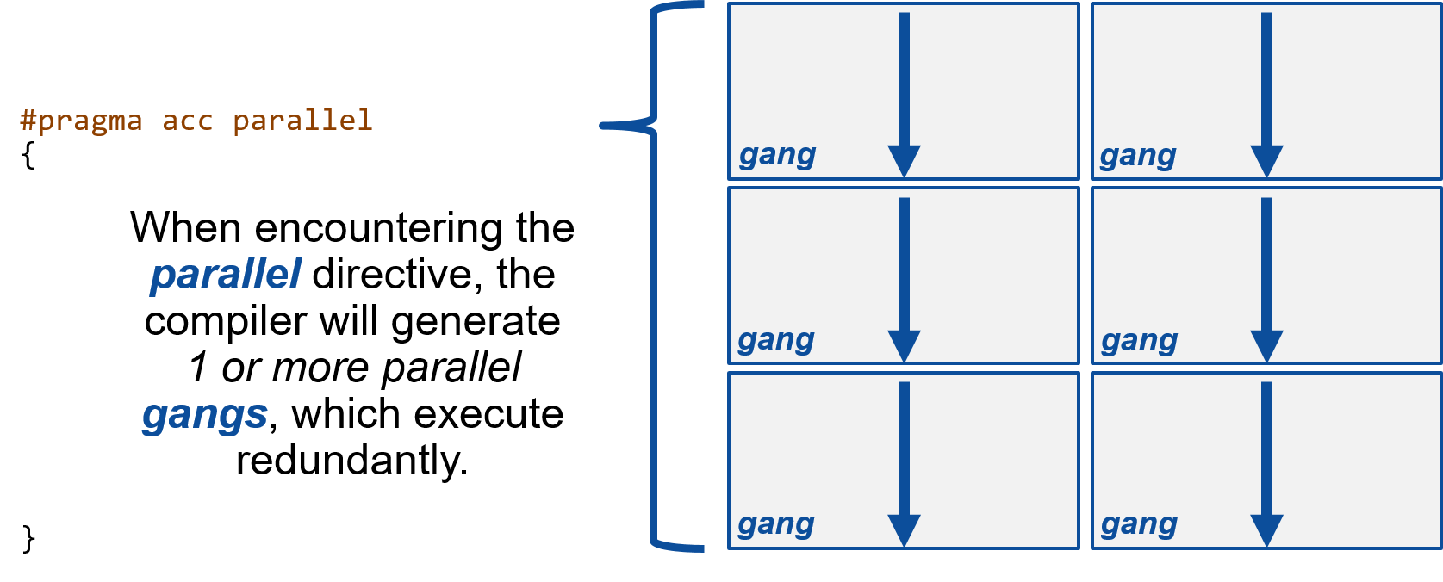
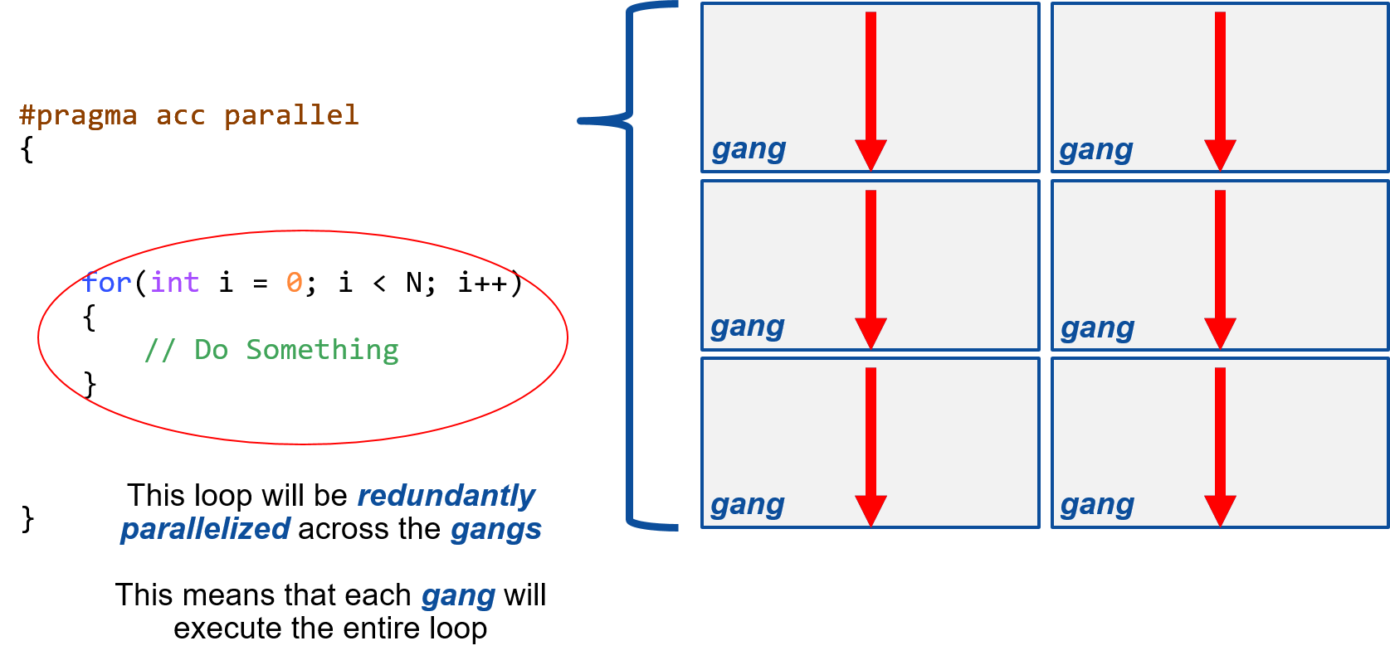
OpenACC Directive
#pragma acc parallel
parallel tells the compiler that this code should be redundantly parallelized

Slide 8
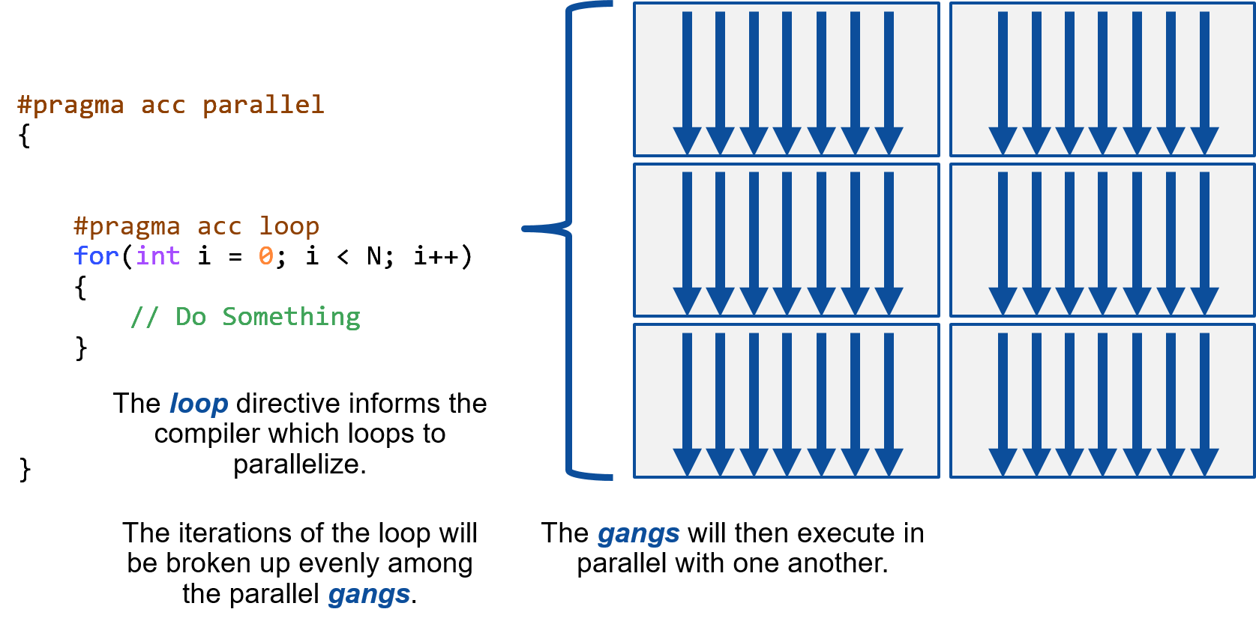
OpenACC Directive
#pragma acc parallel loop
loop tells the compiler that this loop needs to be parallelized
It also tells the compiler that this loop can be safely parallelized.

Slide 9
OpenACC Directive
#pragma acc parallel loop reduction(<operation>:<target>)
reduction tells the compiler that a target is to be reduced
reduce: perform global operations on the selected target
int sum = 0;
#pragma acc parallel loop reduction(+:sum)
for(int i = 0, i < N, i++) sum += i;

Slide 10
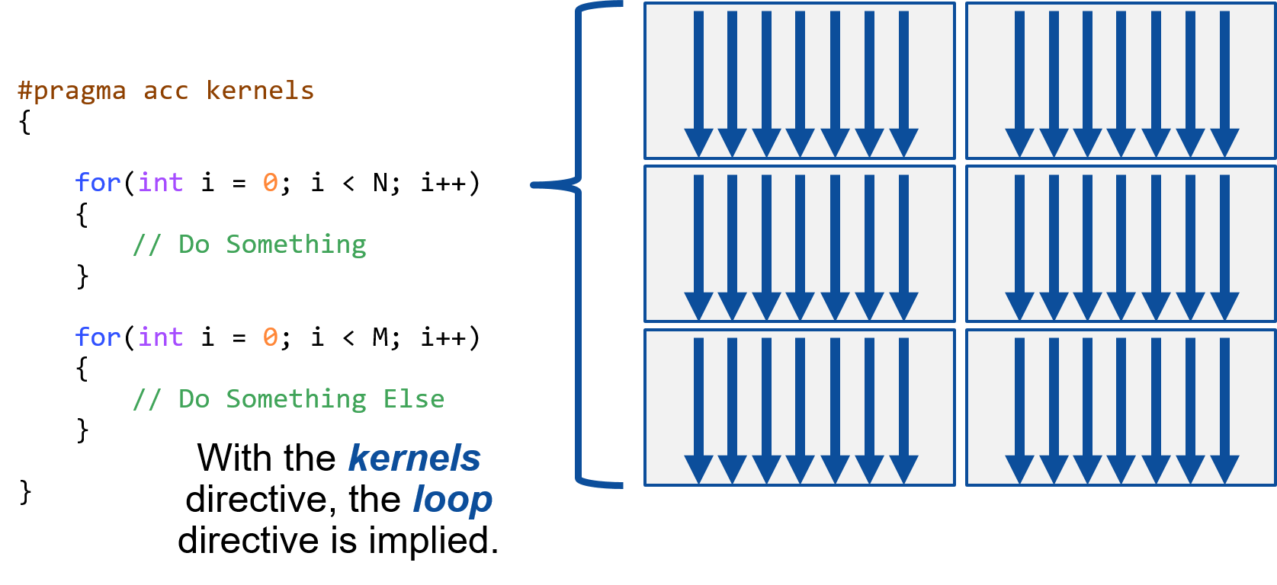
OpenACC Directive
#pragma acc kernels
All actions are decided by the compiler
You can also include the sequential code

Slide 11
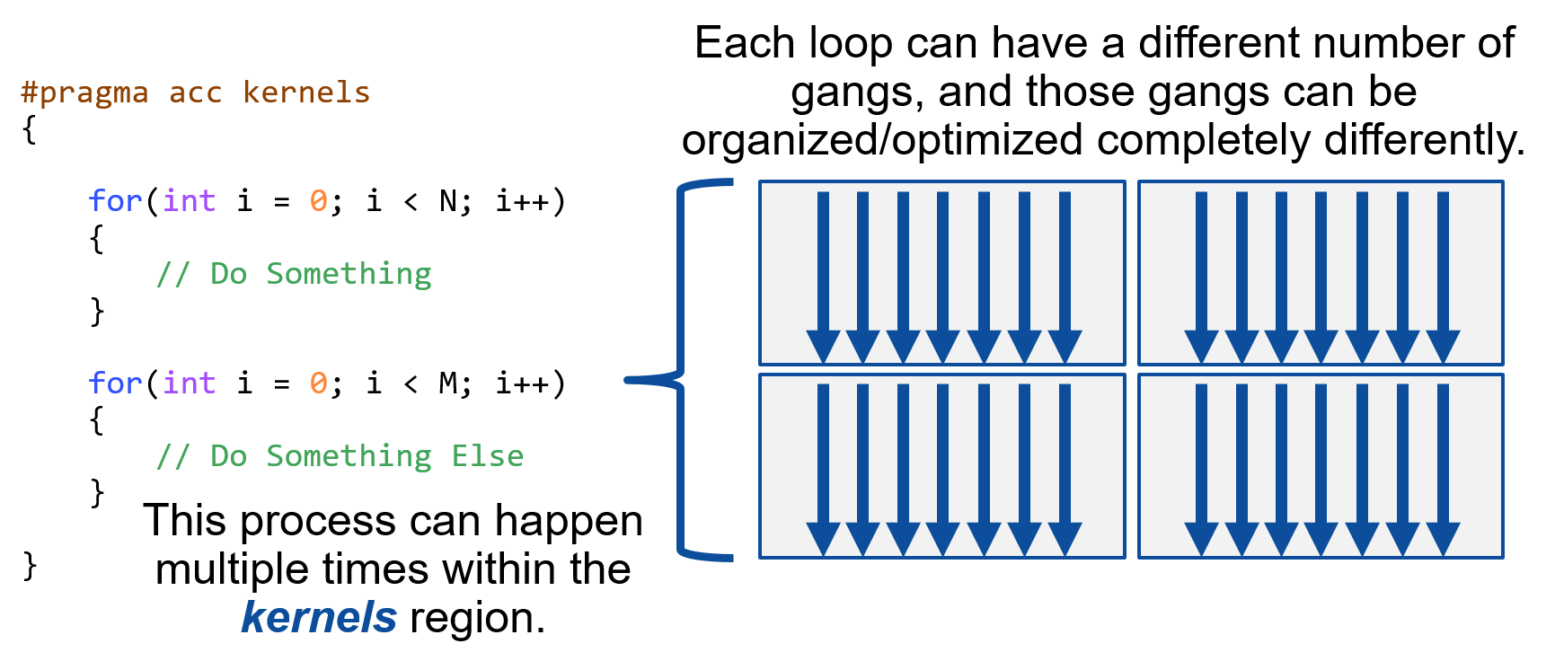
OpenACC Directive
#pragma acc kernels loop independent
Tell the compiler that this loop can be safely parallelized, and force parallelization of it

Slide 12
Data Management
You can copy only part of the data
#pragma acc parallel loop copy(A[1:N-2])
#pragma acc data copy(...)
Copy the data into the GPU and copy the data back to the CPU after the parallel region ends
#pragma acc data copyin(...)
Copy the data into the GPU and delete the data on the GPU after the parallel region ends.
#pragma acc data copyout(...)
Copy the data back to the CPU and delete the data on the GPU after the parallel region ends.
#pragma acc data create(...)
Declare a space on the GPU without performing any copying operations
When there are variables for temporary storage, using this clause eliminates the need to copy in and out.

Slide 13
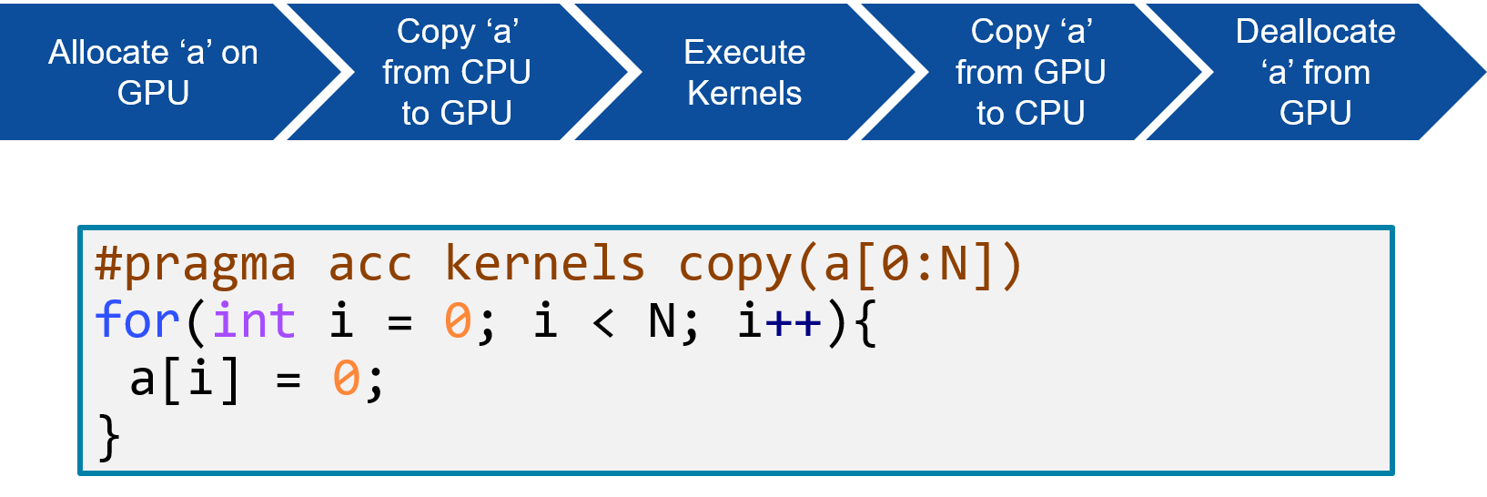
Data Management
#pragma acc data copy(A[0:N])
#pragma acc parallel
{
#pragma acc loop
for(int i = 0; i < N; i++) A[i] = 0;
}

Slide 14
Loop Optimization
#pragma acc parallel loop collapse(...)
Can be used in tightly nested loops
collapse can flatten loops and turn multiple loops into one large parallel loop
#pragma acc parallel loop collapse( 2 )
for(int j = 0; j < M; j++) {
for(int k = 0; k < Q; k++) {
< loop code >
}
}
TIP1:
When the outer loop is too small, flattening the loop can increase GPU usage.

Slide 15
Loop Optimization
#pragma acc parallel loop tile(x, y)
Calculate loop break for multiple tiles (blocks)
#pragma acc parallel loop tile( 32, 32 )
for(int j = 0; j < 128; j++) {
for(int k = 0; k < 128; k++) {
< loop code >
}
}
TIP1:
Try to make the tile size a multiple of 32. The threads in a worker and vector of Nvidia GPU are executed in units of 32.
TIP2:
Do not use tiles larger than 32*32, because in NVIDIA GPU, the maximum number of threads in a gang is 1024 (32*32)

